Slide 1
Design patterns in laravel say goodbye to Messy code and start organize coding

Slide 2
What is design pattern?
Proven solutions to recurring problems in software design. Think of them as reusable templates for tackling common coding challenges .
They’re like the grammar of clean code
They help you communicate well with your team and your future self

Slide 3
Why are design patterns important?
Scalability – ensures your code remain manageable
Maintainability – patterns enforce separation of concerns, making it easier to debug and extend your application
Team collaboration – makes your codebase familiar and accessible to other developers

Slide 4
How laravel 11 supports Design patterns?
Service provider – for the service pattern
Eloquent models – perfect for repository pattern
Observers – built-in implementation for the observer pattern
Singleton pattern – used in service providers to ensure a single instance of a class
Factory pattern – Model factories allow you to create test data and seeders effortlessly.

Slide 5
When to use design patterns?
Be careful : Not every project need design patterns
small projects – use Factory pattern for object creation and testing
Medium projects – add Repository and Service patterns for scalability.
Large projects – use Strategy , Singleton and Observer patters for modularity

Slide 6
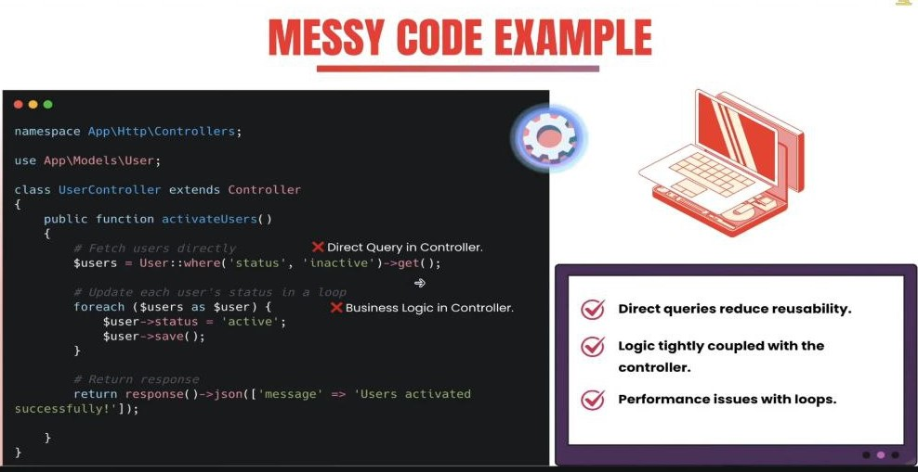

Slide 7
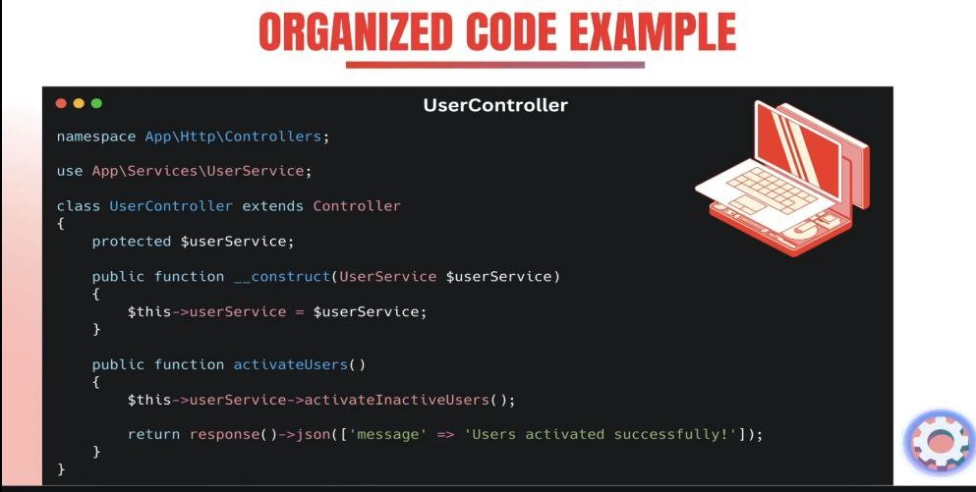

Slide 8
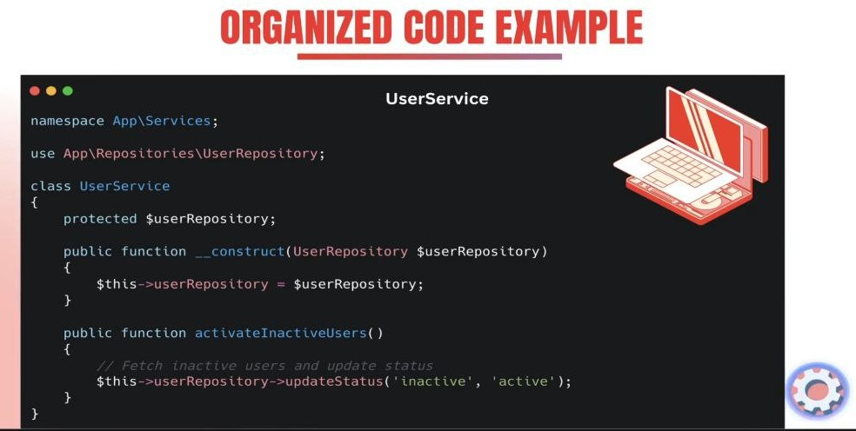

Slide 9
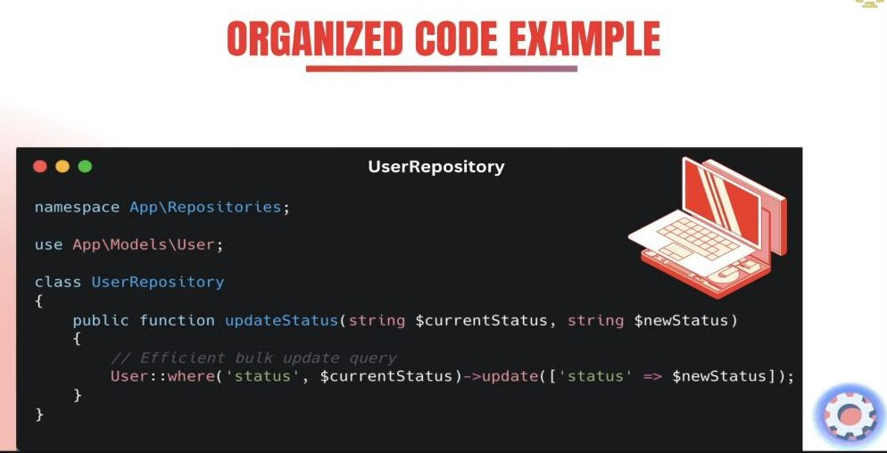

Slide 10


